Slide 1
Atlanta Code Camp
September 14, 2019 // Southern Polytechnic State University

Slide 2

Azure App Service Authentication & Authorization
Ryan Hill (@chillnryan)
Software Engineer | Azure CXP Community
https://github.com/chillryan
Notes:
About me
What I do in Azure CXP Community
Why did I decide to do this talk

Slide 3
Agenda
Introduction
Managed Identity Platform???
Let's get it started...in here
Resources

Slide 4
Introduction
Using SDKs that utilize OAuth and OpenID industry standards
Secure your Web apps and resources
Notes:
Use ADAL.net and MSAL.net
MSAL.net library is based off v2 (which is where you want to be)
Why use SQL auth when you can use managed identity

Slide 5
Managed Identity Platform
Full featured platform for Microsoft Identity services through OAuth and OpenId
SDK options are MSAL (v2) and ADAL (v1)

Slide 6
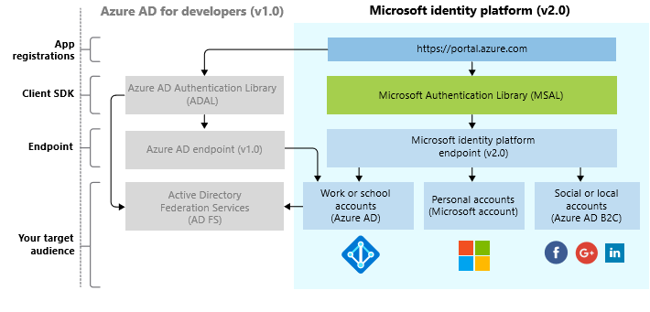
Notes:
Host of other things that you can do; MFA, Policies, B2C and B2B
Basic principal app service will forward the request to AAD, have the user sign-in, consent if needed, and redirect to your application

Slide 7
Let’s get it started...
Register your app
Make use of the quick starts
Remember, friends don’t let friends

Slide 8
References
https://aka.ms/identityplatform
https://docs.microsoft.com/azure/active-directory/develop/active-directory-v2-libraries
https://docs.microsoft.com/en-us/azure/app-service/app-service-web-tutorial-connect-msi#grant-database-access-to-azure-ad-user
https://github.com/chillryan/DemoAzureAd

Slide 9

Platinum Sponsors

Slide 10





Gold Sponsors

Slide 11

Special Thanks

